Slide 1
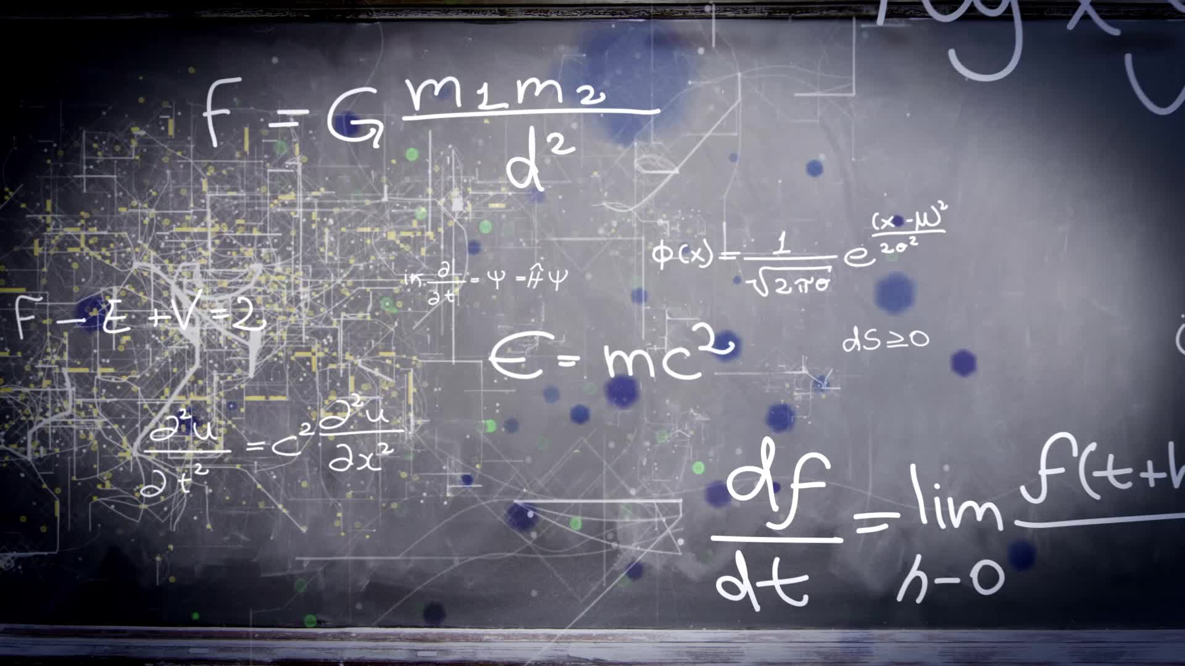
Chapter P.2:
LINEAR MODELS & RATES OF CHANGE
HONORS CALCULUS/CALCULUS

Slide 2
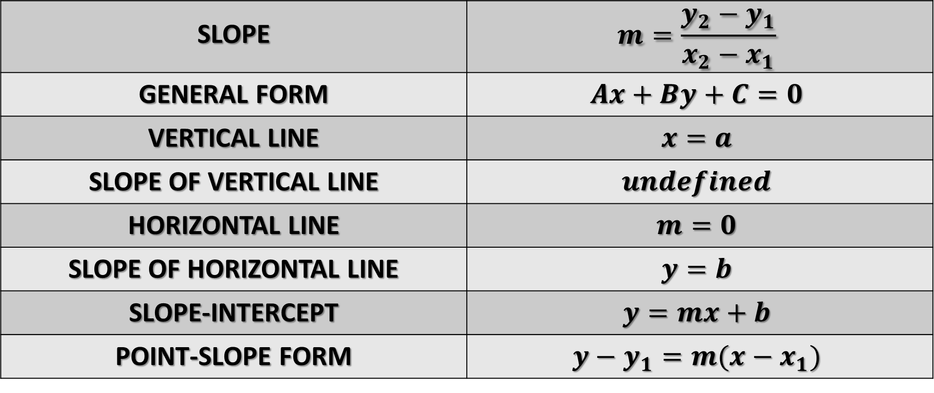
SUMMARY OF EQUATIONS OF LINES
SLOPE | $$m=\frac{y_{2}−y_{1}}{x_{2}−x_{1}}$$
GENERAL FORM | $$Ax+By+C=0$$
VERTICAL LINE | $$x=a$$
SLOPE OF VERTICAL LINE | $$undefined$$
HORIZONTAL LINE | $$m=0$$
SLOPE OF HORIZONTAL LINE | $$y=b$$
SLOPE-INTERCEPT | $$y=mx+b$$
POINT-SLOPE FORM | $$y−y_{1}=m(x−x_{1})$$
Parallel Lines have Slopes that are EQUAL.
Perpendicular Lines have NEGATIVE RECIPROCAL SLOPES.

Slide 3
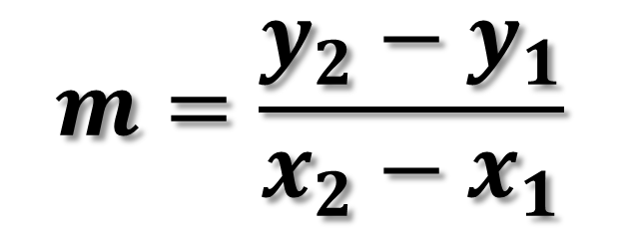
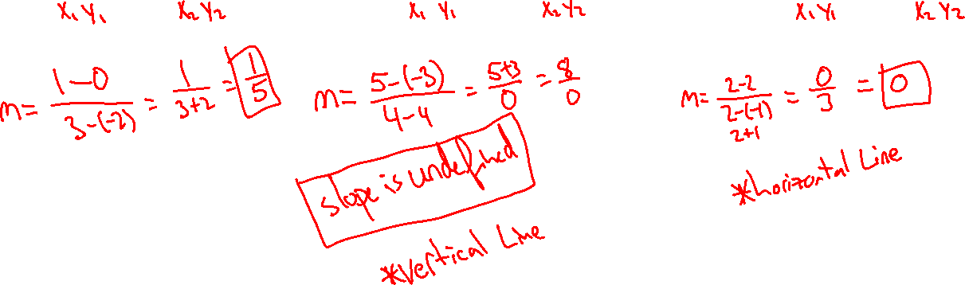
FIND THE SLOPE OF THE LINES PASSING THROUGH THE TWO GIVEN POINTS
$$m=\frac{y_{2}−y_{1}}{x_{2}−x_{1}}$$
A.) (-2,0) and (3,1) B.) (4,-3) and (4,5) C.) (-1,2) and (2,2)

Slide 4

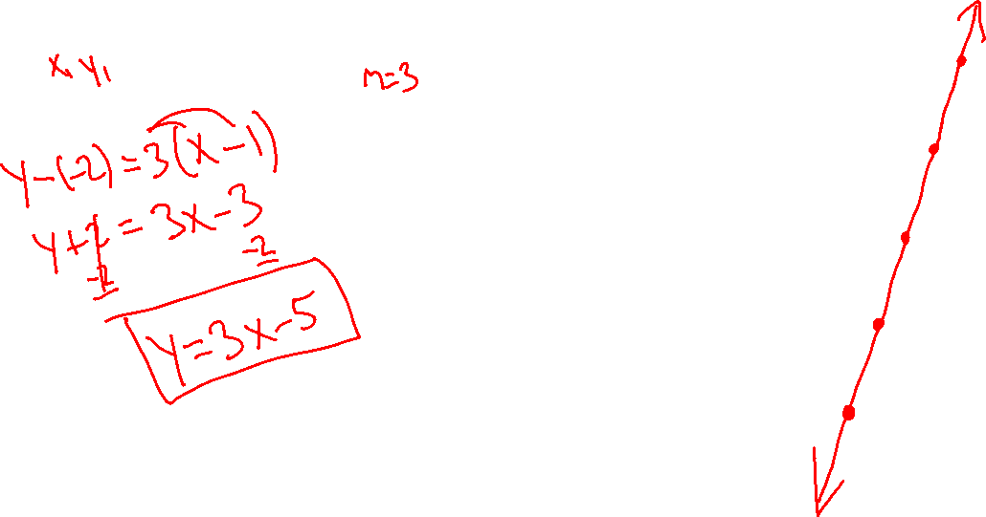

Point-slope Form of the Equation of a Line
y – y₁ = m(x – x₁)
Given a point (x₁,y₁) and slope m
1.) Find an equation of the line that passes through the point (1,-2) and has a slope of 3. Sketch the graph.

Slide 5





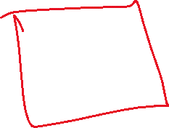


Point-slope Form of the Equation of a Line
y – y₁ = m(x – x₁)
Given a point (x₁,y₁) and slope m
2.) Find an equation of the line that passes through the point (3, 8) and has a slope of undefined. Sketch the graph.

Slide 6






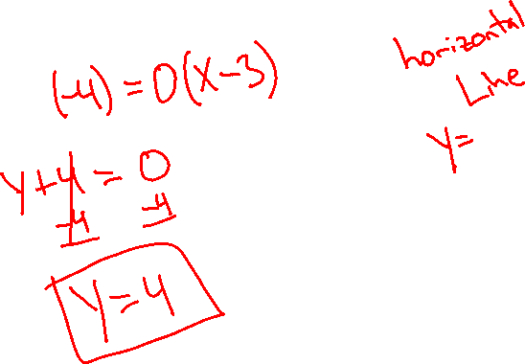


Point-slope Form of the Equation of a Line
y – y₁ = m(x – x₁)
Given a point (x₁,y₁) and slope m
3.) Find an equation of the line that passes through the point (3, -4) and has a slope 0. Sketch the graph.

Slide 7
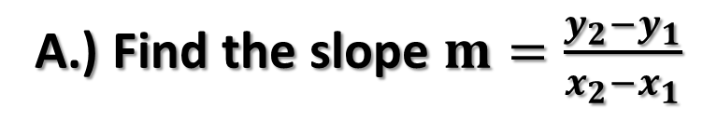
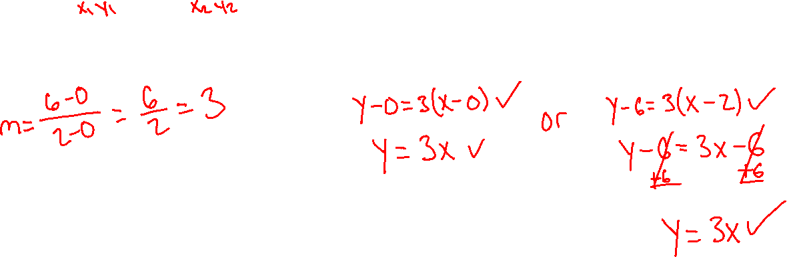
Point-slope Form of the Equation of a Line
y – y₁ = m(x – x₁)
Given a point (x₁,y₁) and slope m
4.) Find an equation of the line that passes through the points (0, 0) and (2, 6).
A.) Find the slope $m=\frac{y_{2}−y_{1}}{x_{2}−x_{1}}$
B.) Use point-slope formula y – y₁ = m(x – x₁)

Slide 8
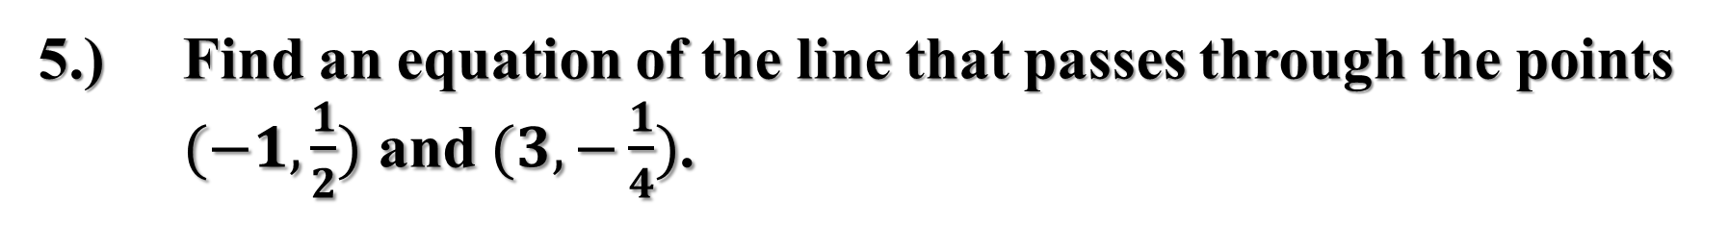
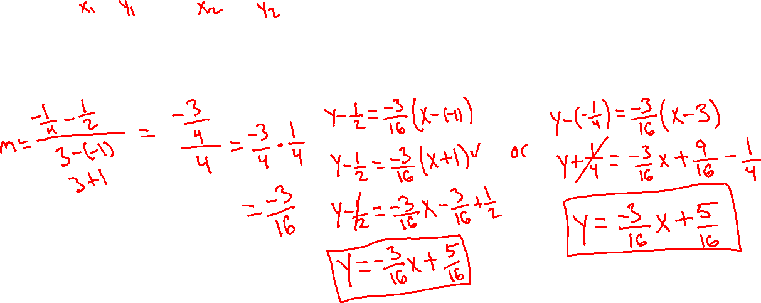
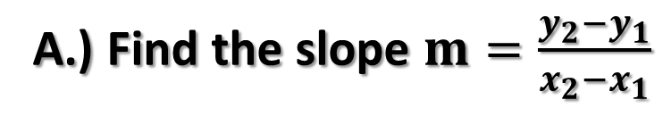
Point-slope Form of the Equation of a Line
y – y₁ = m(x – x₁)
Given a point (x₁,y₁) and slope m
5.) Find an equation of the line that passes through the points $(−1,\frac{1}{2})$ and $(3,−\frac{1}{4})$.
A.) Find the slope $m=\frac{y_{2}−y_{1}}{x_{2}−x_{1}}$
B.) Use point-slope formula y – y₁ = m(x – x₁)

Slide 9
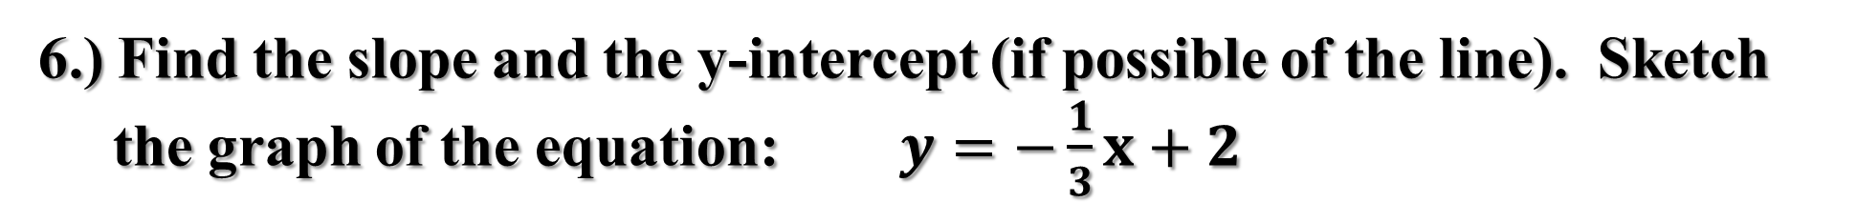
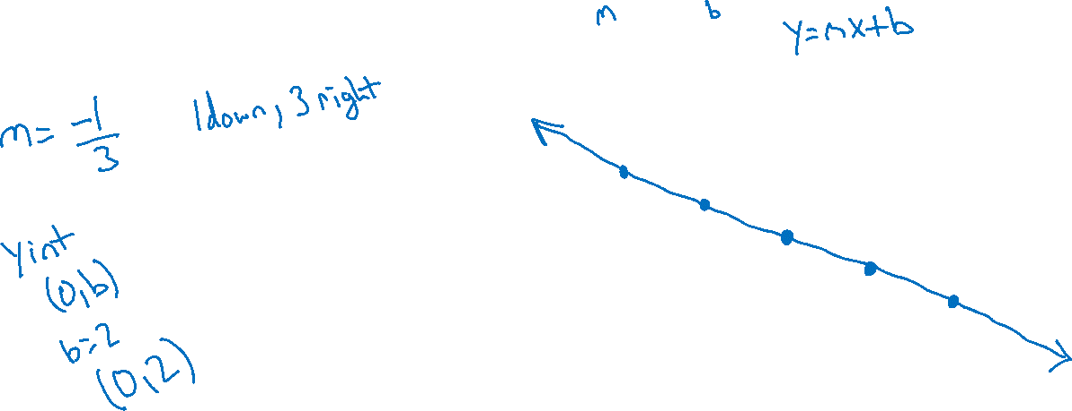
6.) Find the slope and the y-intercept (if possible of the line). Sketch
the graph of the equation: $y=−\frac{1}{3}x+2$

Slide 10
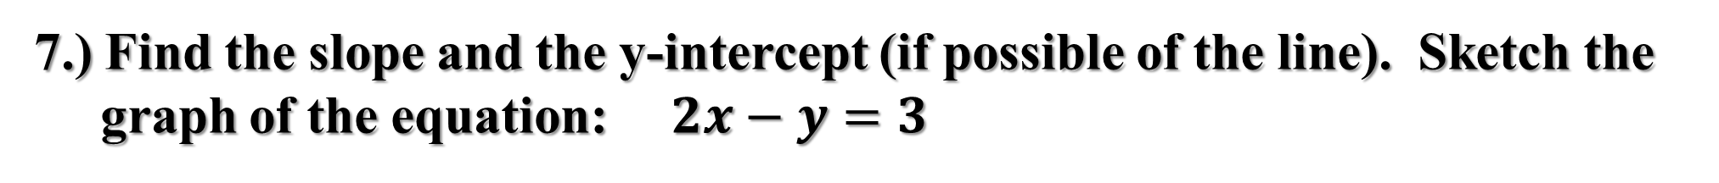
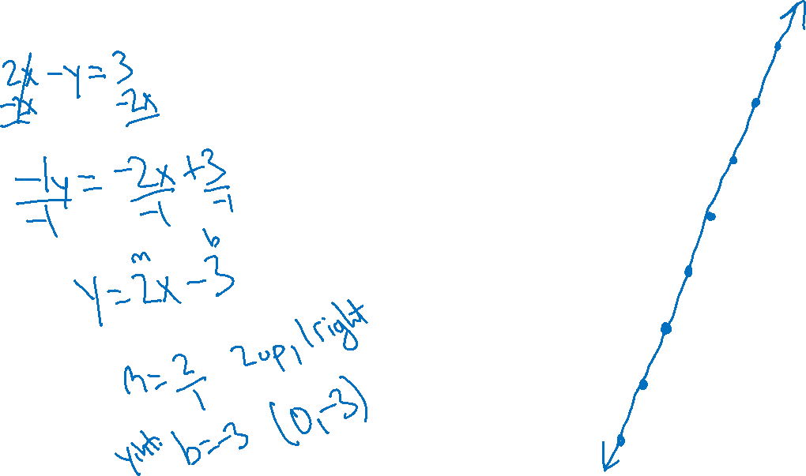
7.) Find the slope and the y-intercept (if possible of the line). Sketch the
graph of the equation: $2x−y=3$

Slide 11
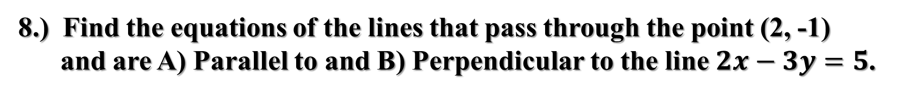
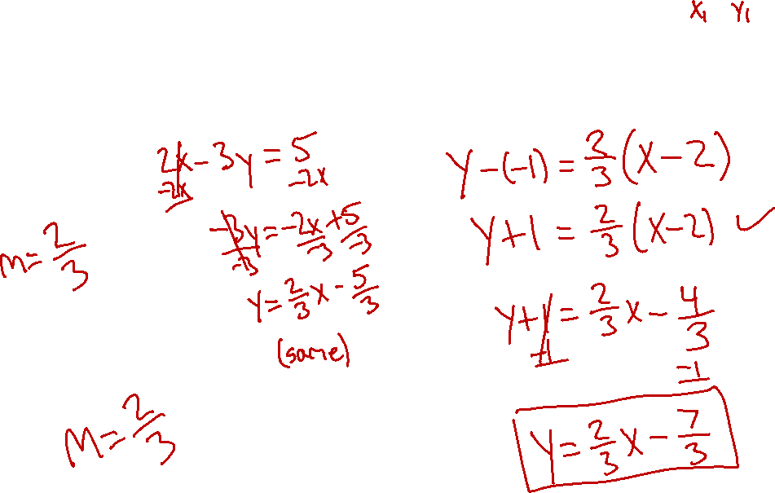
8.) Find the equations of the lines that pass through the point (2, -1)
and are A) Parallel to and B) Perpendicular to the line $2x−3y=5$.
PART A
First, solve for y and find the slope of the line.
Use y – y₁ = m(x – x₁)
Second, find the parallel slope.

Slide 12
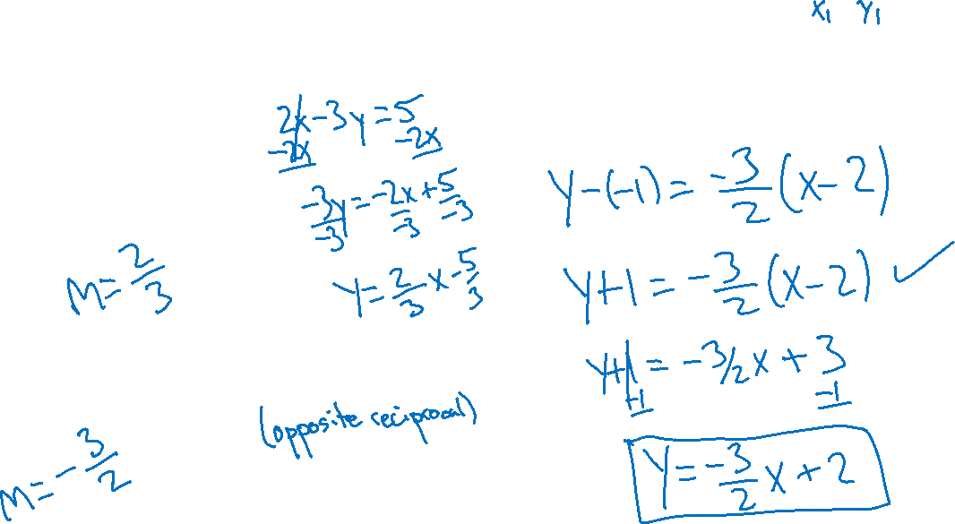
8.) Find the equations of the lines that pass through the point (2, -1)
and are A) Parallel to and B) Perpendicular to the line $2x−3y=5$.
PART B
First, solve for y and find the slope of the line.
Use y – y₁ = m(x – x₁)
Second, find the perpendicular slope.

Slide 13
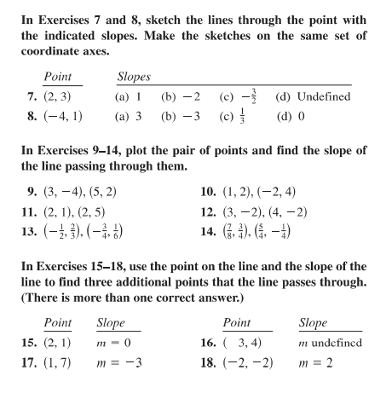
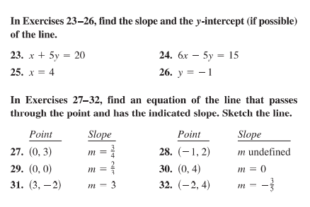

Slide 14
